Slide 1
Manual Testing Project
Sabari Sundar A R (Team Lead)
Abhijith Suresh
Dona Binu
Daniel Pavun Raj R
Sudharsen R J

Slide 2
INTRODUCTION
About the Project
The project involves comprehensive manual testing of the website “www.mayoclinic.org”, a trusted healthcare platform offering integrated medical information and services.
Purpose of Testing
To verify the functionality and usability of key modules in the Mayo Clinic website such as:
User Registration
Diseases & Symptoms
Find a doctor
Job Search
Donation

Slide 3
OBJECTIVE
Primary Goal
To validate the core functionalities of the Mayo Clinic website and ensure a seamless user experience across all modules.
Specific Objectives
Verify that users can search and find doctors efficiently.
Ensure job search features work accurately with filters and error handling.
Confirm that users can donate securely using preferred payment methods.
Validate disease and symptom search with detailed information and multilingual support.
Test registration workflows for new users, including verification and category selection.
Outcome
To successfully execute a comprehensive manual testing cycle that identifies and documents functional issues and potential usability improvements in the Mayo Clinic website ensuring that the website is reliable and working as intended.

Slide 4
ABOUT THE PROJECT
Project Overview
This project focuses on testing key functionalities of the website “www.mayoclinic.org”, a leading healthcare platform.
Modules Covered
  Find a Doctor – Search by name, condition, or location.
  Job Search – Explore career opportunities with filters.
  Donation – Contribute securely to Mayo Clinic initiatives.
  Diseases & Symptoms – Access detailed disease information, procedures, and clinical trials.
  User Registration – Register and verify details for personalized services.
Testing Approach
  Validate functional accuracy of each module.
  Ensure error handling and user-friendly navigation.
  Confirm secure transactions and data integrity.

Slide 5
TESTING PROCESS
1. Requirement Analysis
  - Review epics and user stories for each module.
  - Identify functional and non-functional requirements.
2. Test Planning
  - Define scope, objectives, and testing approach.
  - Prepare test strategy and resource allocation.
3. Test Case Design
  - Create detailed test cases for:
    - Positive scenarios
    - Negative scenarios
    - Edge cases
  - Map test cases to user stories for coverage.
4. Test Environment Setup
  - Configure application environment.
  - Ensure data readiness and connectivity.

Slide 6
TESTING PROCESS
5. Test Execution
  - Perform functional testing for all modules.
  - Validate workflows, error handling, and UI behavior.
6. Defect Reporting & Tracking
  - Log defects in tracking tool.
  - Retest after fixes and perform regression testing.
7. Test Closure
  - Prepare test summary report.
  - Validate all objectives are met.

Slide 7
MODULES TESTED
1. Find a Doctor
  - Search by doctor’s name, condition/procedure, and location.
  - View doctor profiles and handle “No results” scenarios.
2. Job Search
  - Search jobs by title, location, and radius.
  - Apply filters and validate error messages for invalid searches.
3. Donation
  - Select or enter donation amount.
  - Choose payment method and complete secure transactions.

Slide 8
MODULES TESTED
4. Diseases & Symptoms
  - Search diseases and symptoms.
  - Access procedures, clinical trials, and multilingual descriptions.
  Connect anonymously with those in need.
5. User Registration
  - Select resident and account category.
  - Verify phone number and complete registration.
  - Contact Mayo Clinic for assistance.

Slide 9
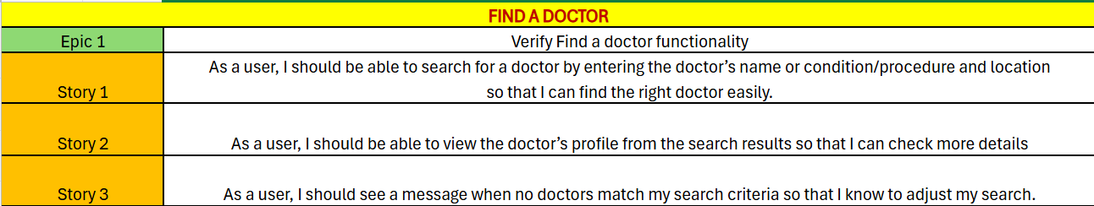
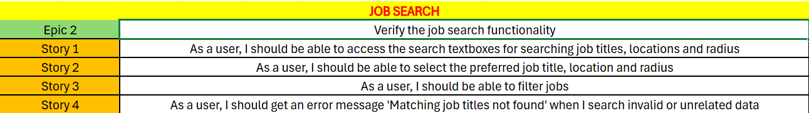
EPICS AND USER STORIES

Slide 10
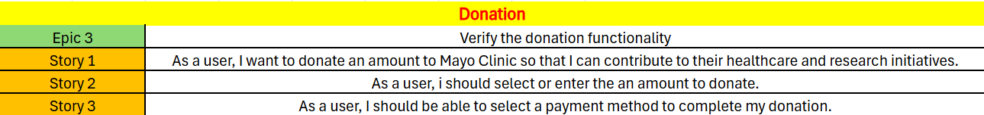
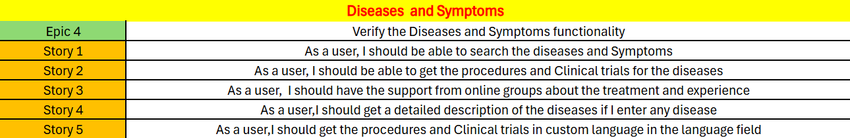
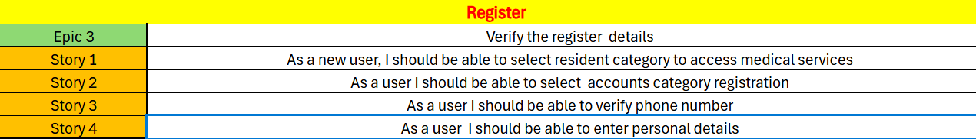
EPICS AND USER STORIES

Slide 11
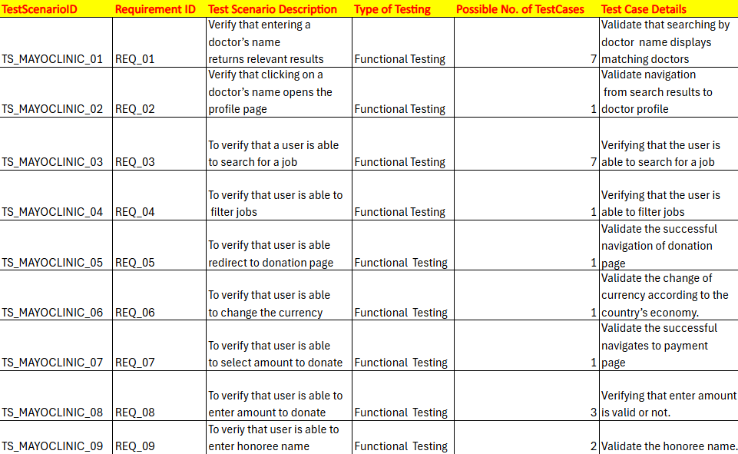
TEST SCENARIOS

Slide 12
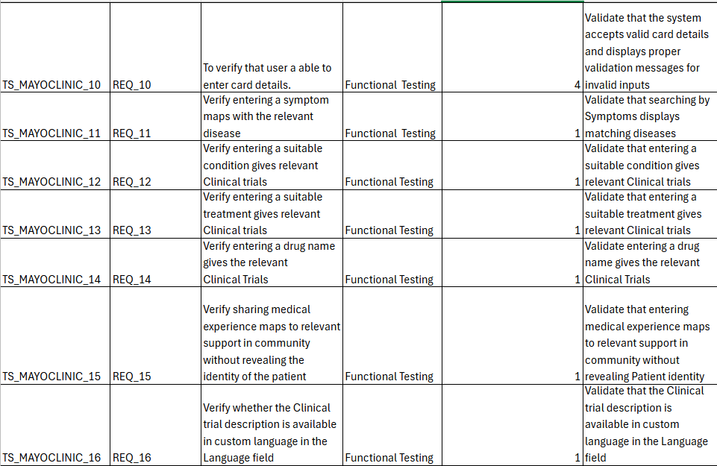
TEST SCENARIOS

Slide 13
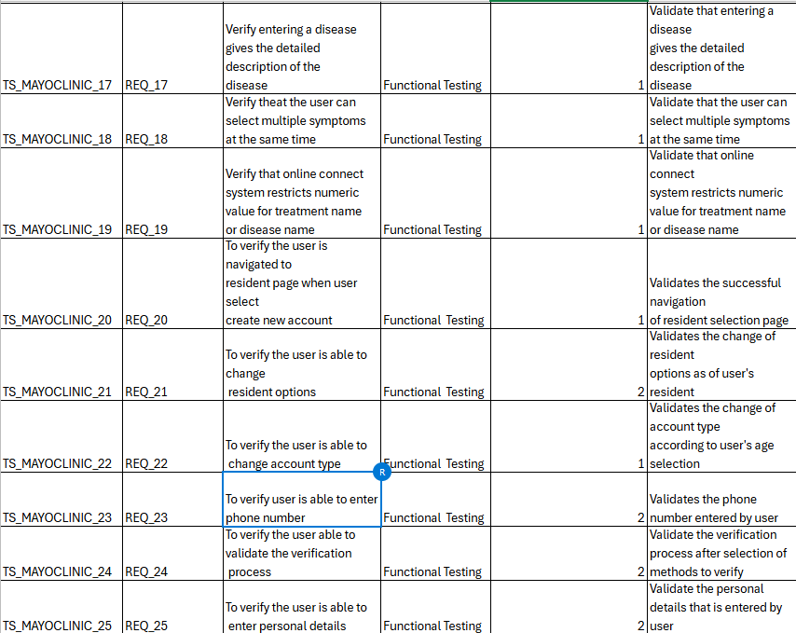
TEST SCENARIOS

Slide 14
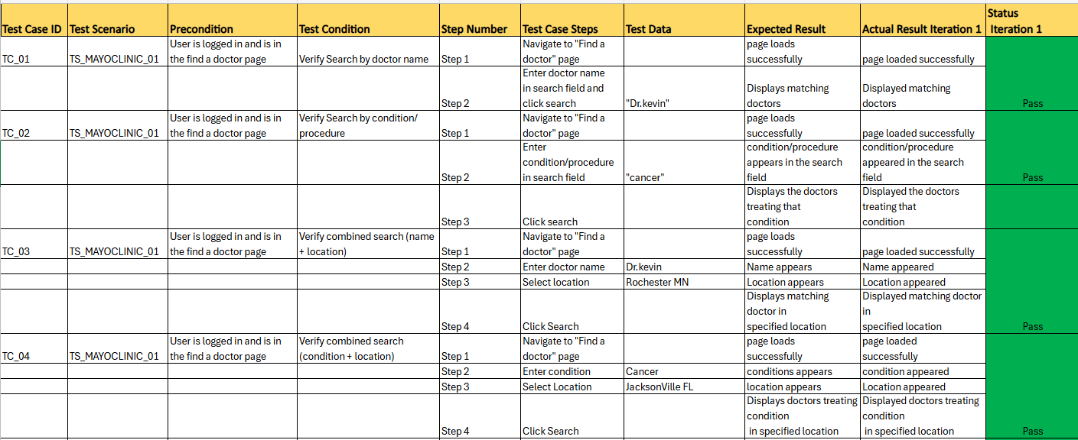
TEST CASES

Slide 15
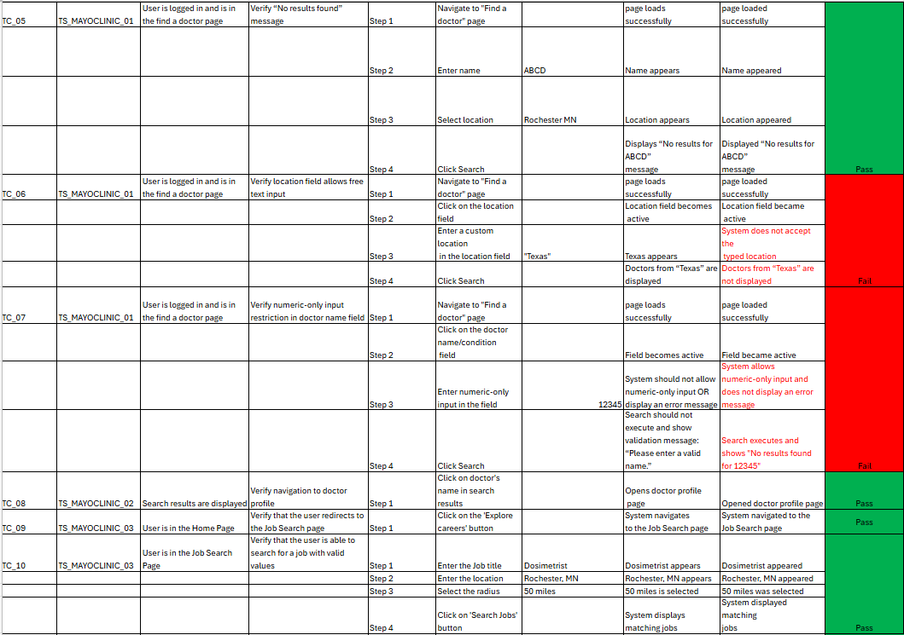
TEST CASES

Slide 16
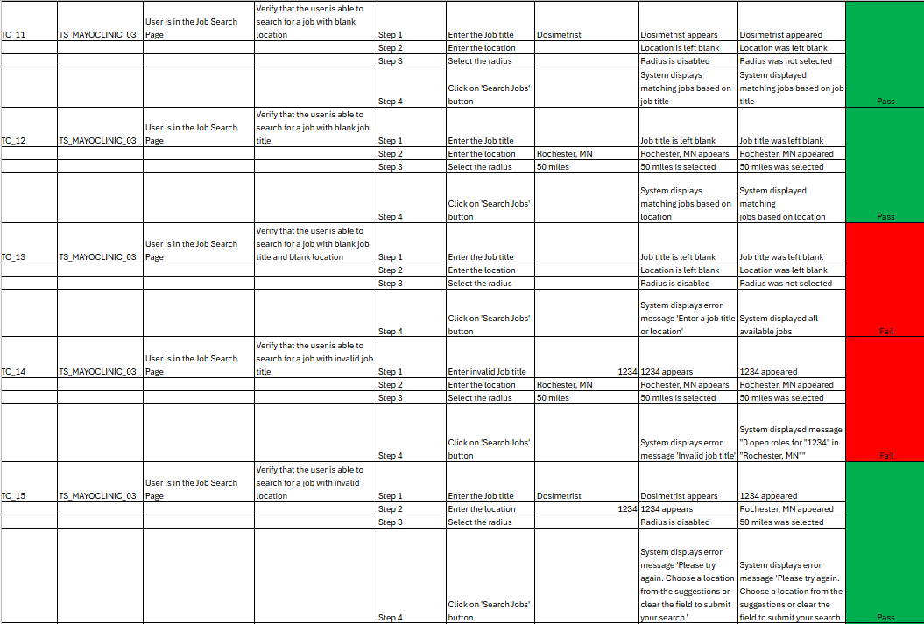
TEST CASES

Slide 17
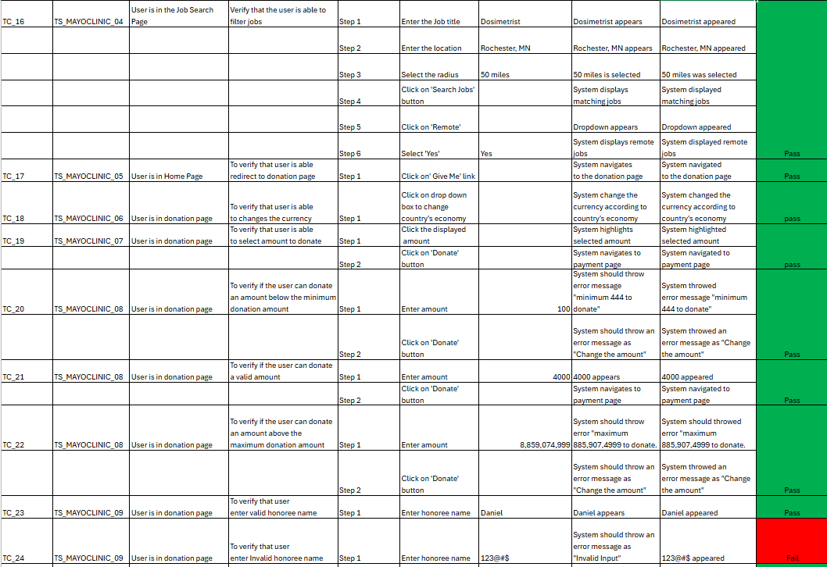
TEST CASES

Slide 18
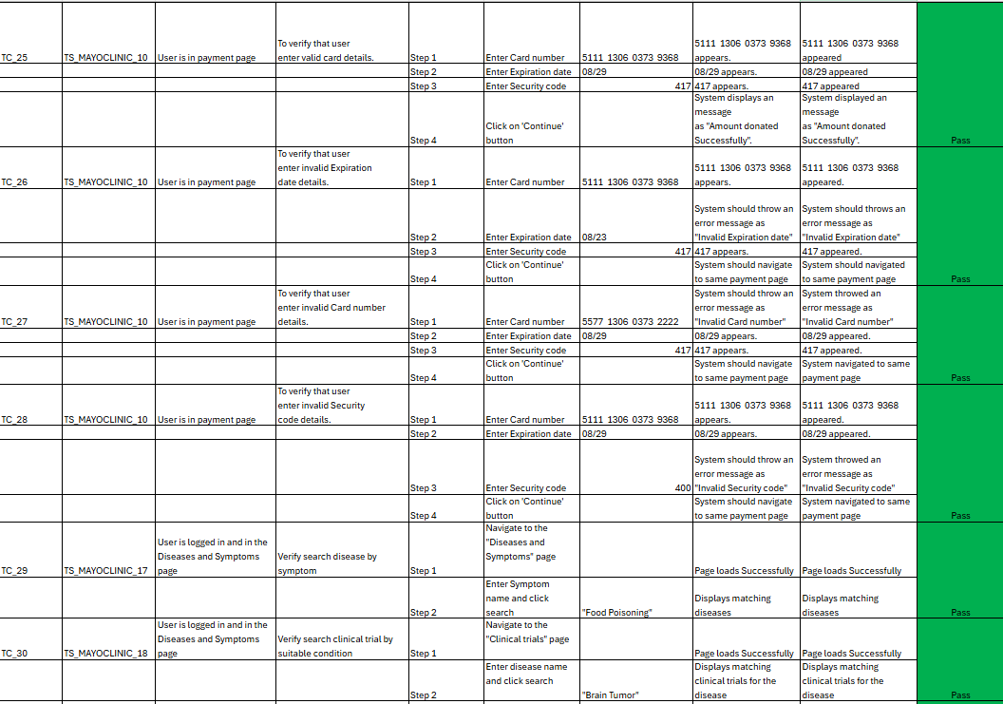
TEST CASES

Slide 19
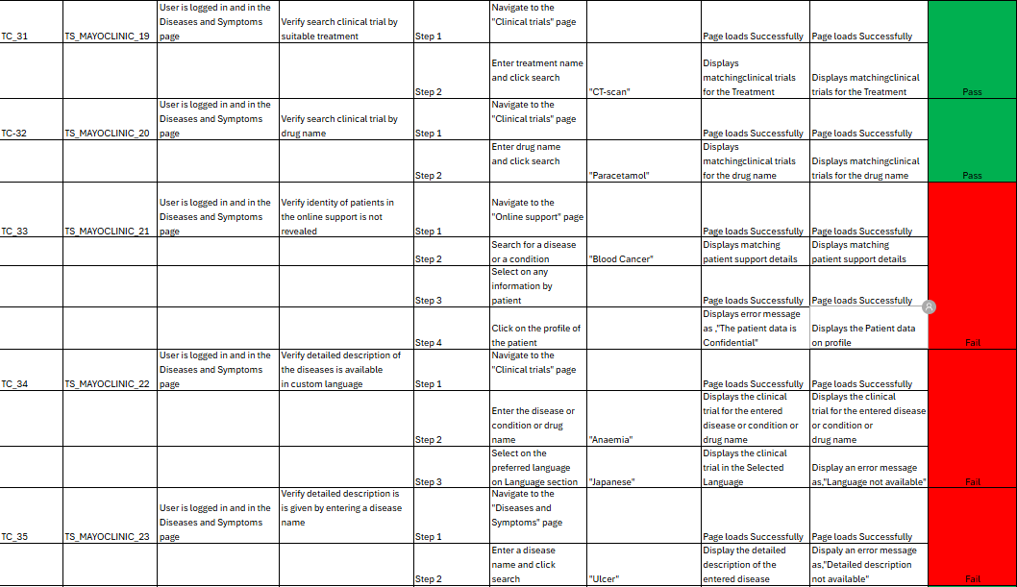
TEST CASES

Slide 20
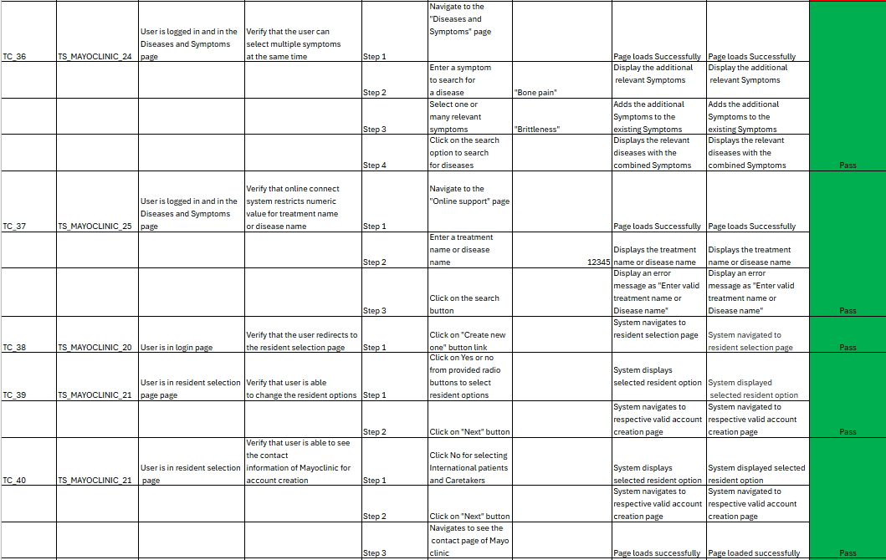
TEST CASES

Slide 21
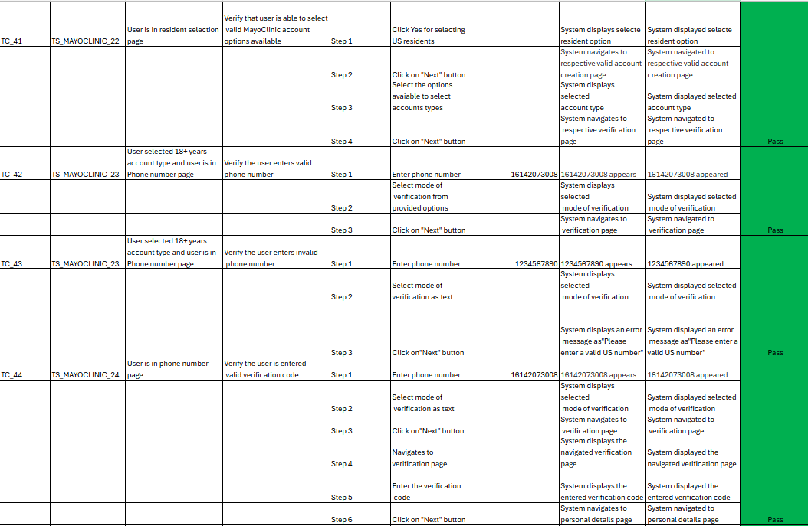
TEST CASES

Slide 22
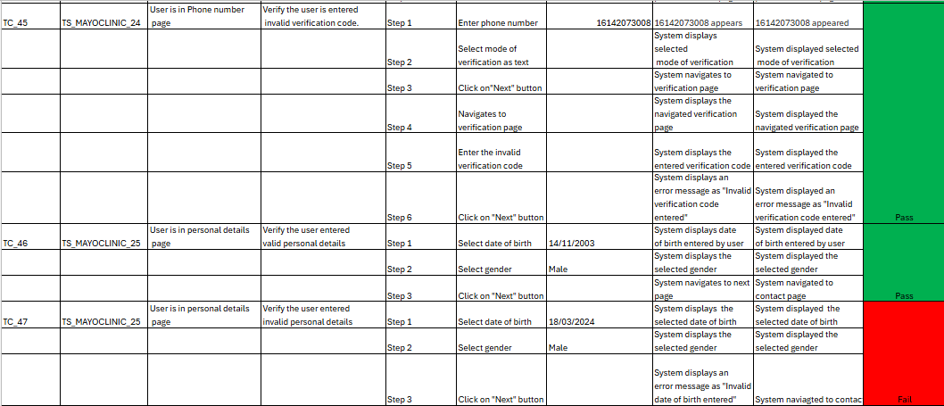
TEST CASES

Slide 23
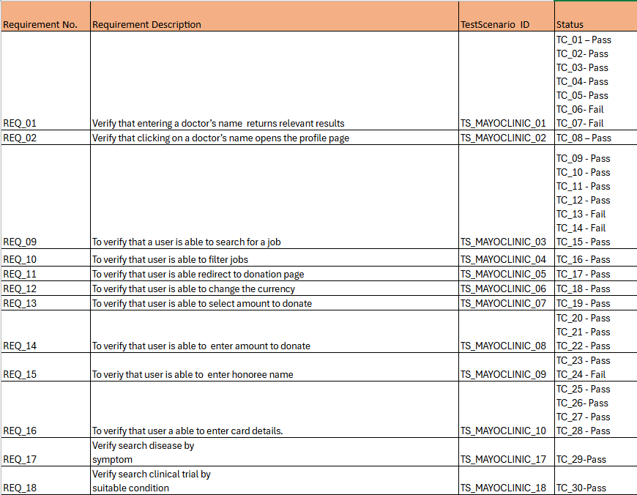
REQUIREMENT TRACEABILITY MATRIX

Slide 24
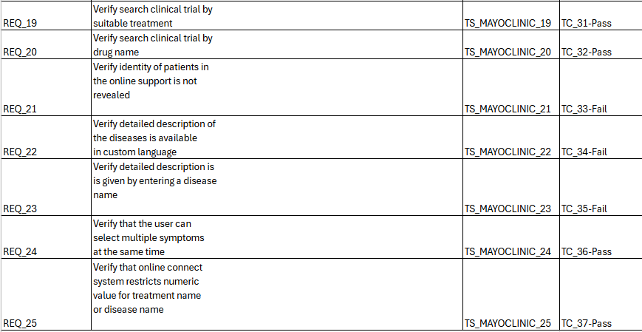
REQUIREMENT TRACEABILITY
MATRIX

Slide 25
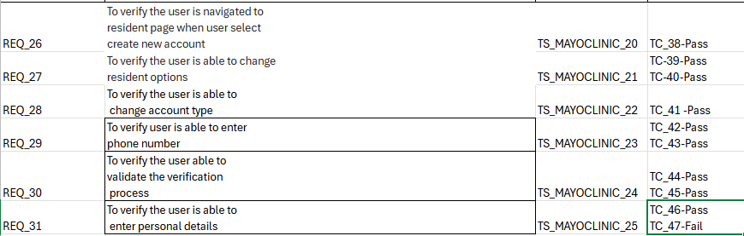
REQUIREMENT TRACEABILITY
MATRIX

Slide 26
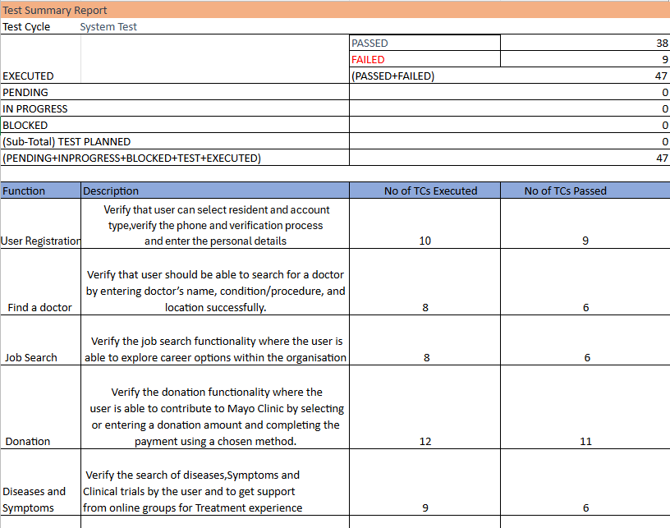
TEST SUMMARY REPORT

Slide 27
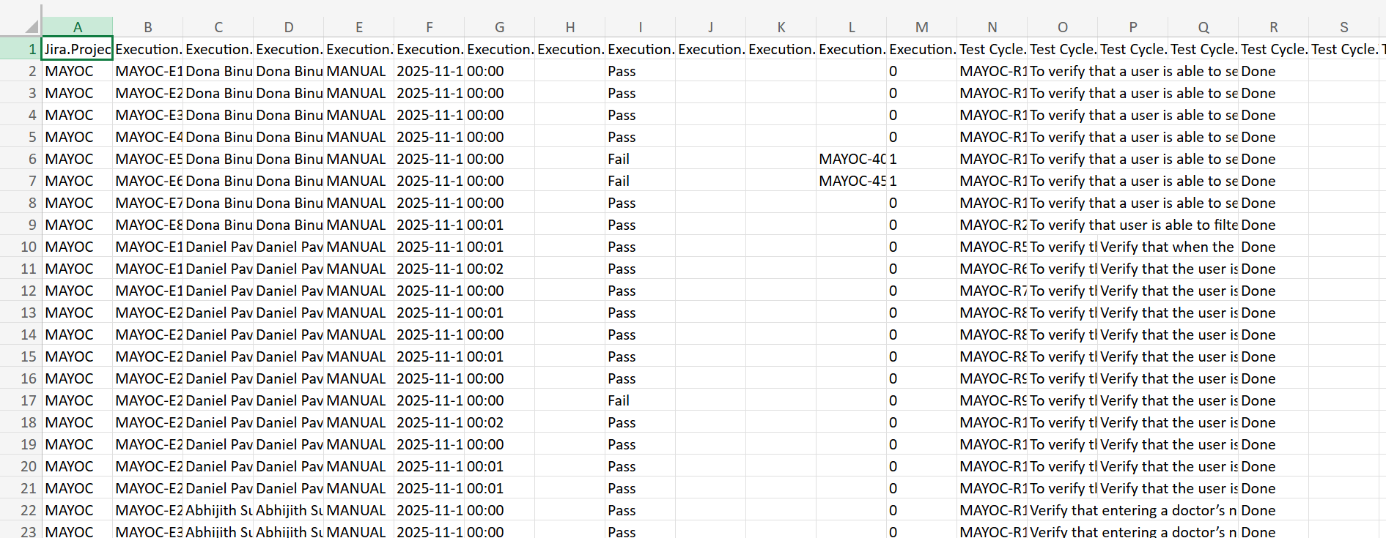
JAVA ARTIFACTS

Slide 28
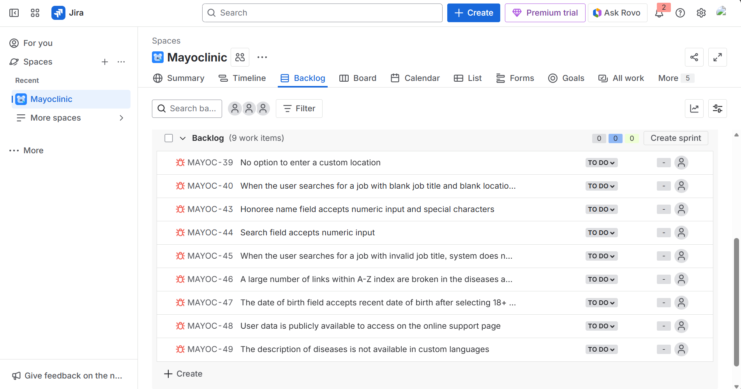
JIRA – PRODUCT BACKLOG

Slide 29
JIRA – SPRINT BACKLOG

Slide 30
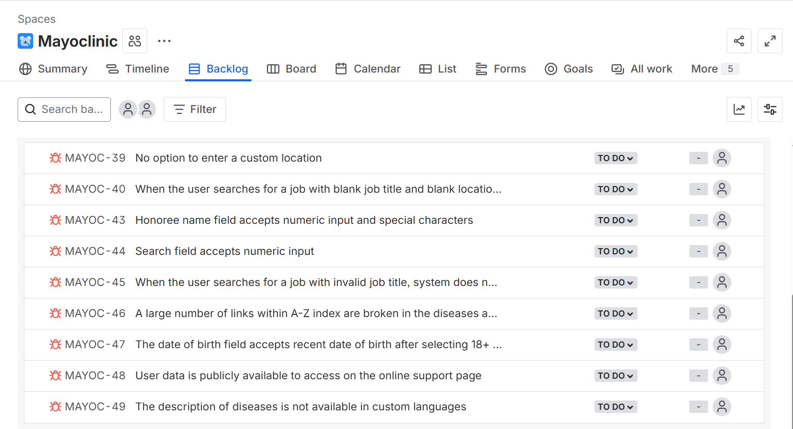
JIRA – DEFECTS

Slide 31
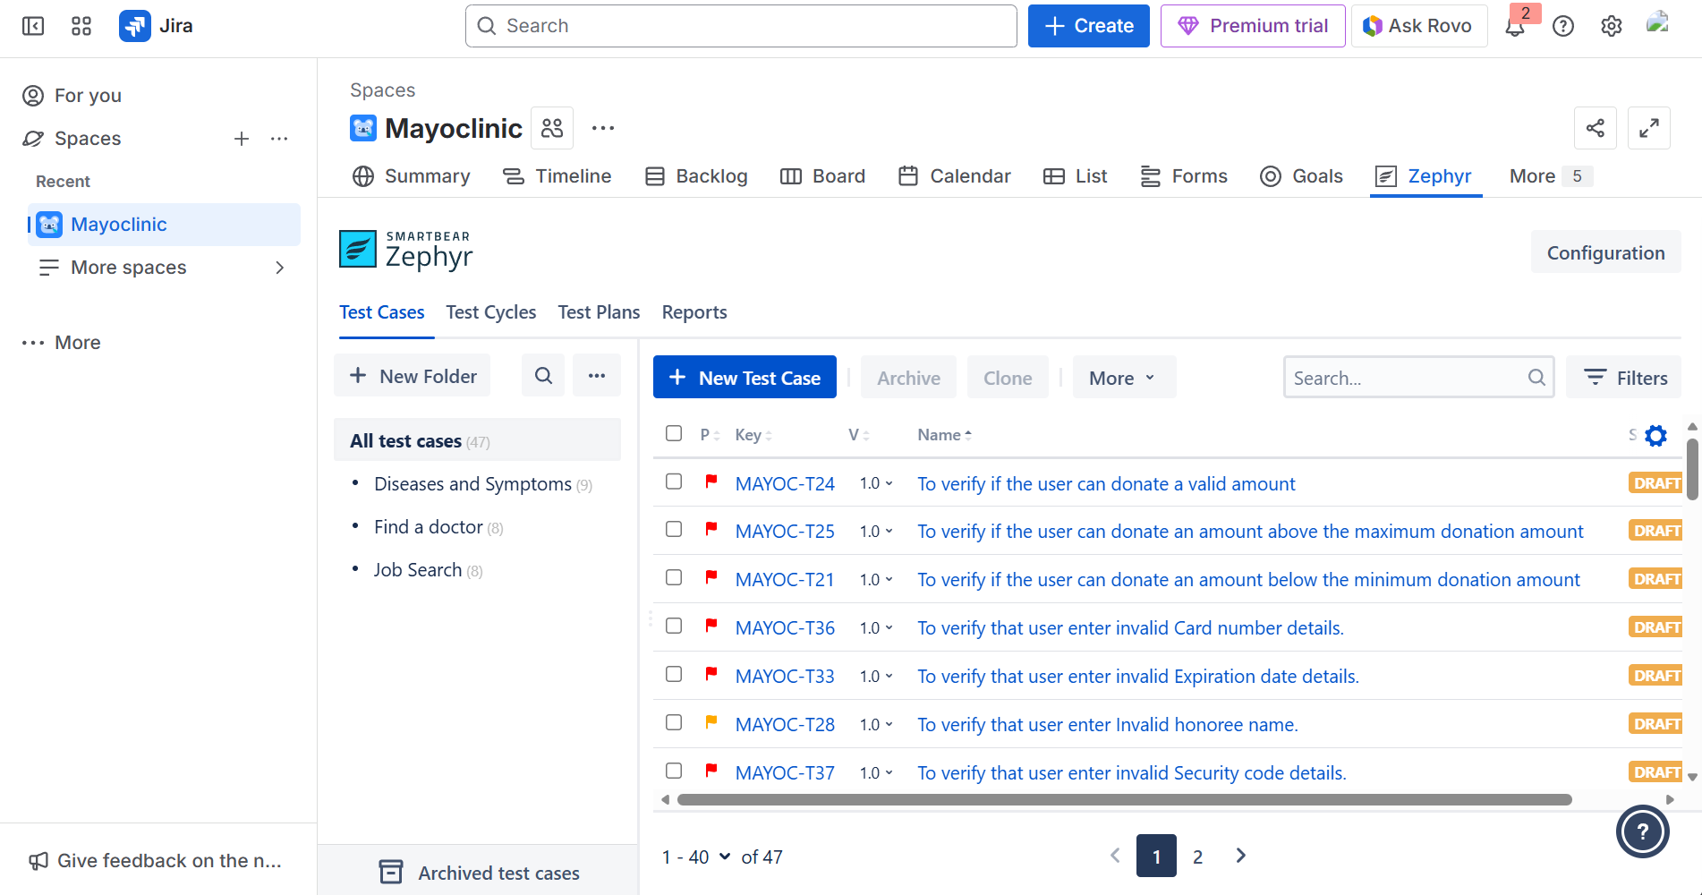
JIRA – TEST CASES

Slide 32
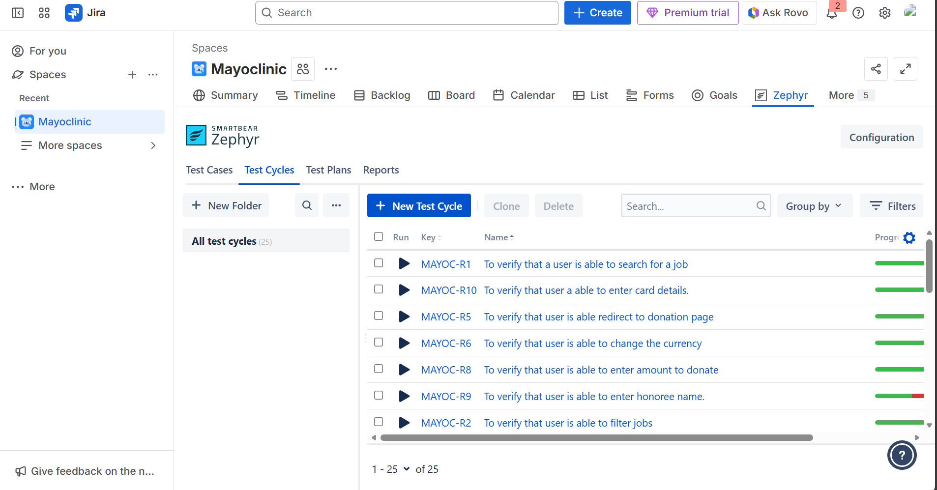
JIRA – TEST CYCLES

Slide 33
ROLES AND RESPONSIBILITIES
Sabari Sundar A R (Team Lead) – Diseases and symptoms module
Abhijith Suresh (Team member) – Find a doctor module
Dona Binu (Team member) – Job search module
Daniel Pavun Raj R (Team member) – Donation module
Sudharsen R J (Team member) – User registration module

Slide 34
CONCLUSION
Successfully executed a comprehensive manual testing cycle that identified and documented functional issues, inconsistencies, and potential usability improvements, contributing to a more reliable and user-centric web experience aligned with Mayo Clinic’s commitment to healthcare excellence.

